Slide 1
Blind estimation of acoustic transfer functions (ATFs) and dereverberation based on convolutive transfer functions (CTFs) Date：2022. 11. 08
Telecom Electroacoustics Audio(TEA) Lab
Presenter:
Anchi Yuan
Notes:
Hello everyone
I’m today’s presenter siang. I’m going to share some of my present work in source separation problem. My topic is comparative studies of source separation using semi-blind and blind source separation approaches.

Slide 2
Outline
Simulation setting
Simulation result

Slide 3
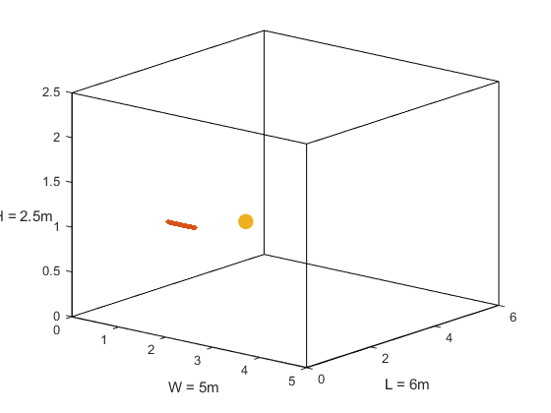
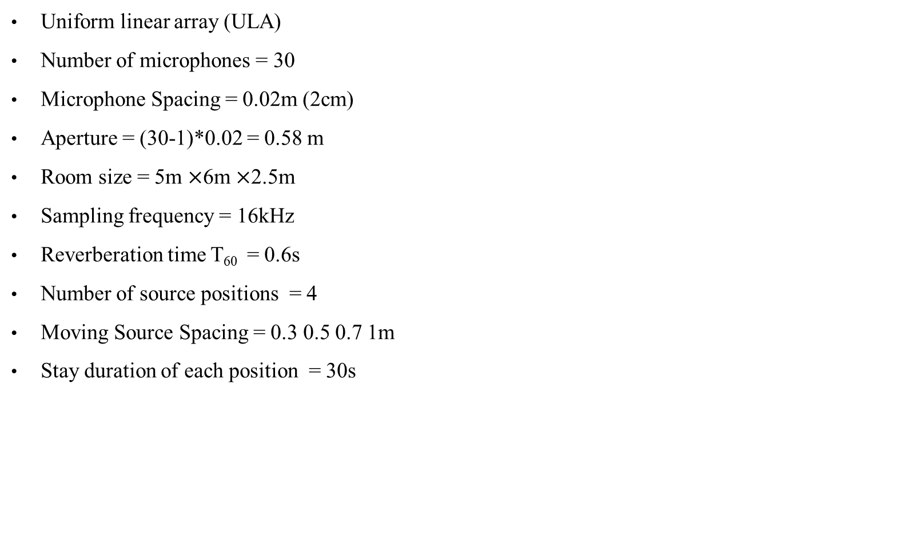
Simulation setting
Uniform linear array (ULA)
Number of microphones = 30
Microphone Spacing = 0.02m (2cm)
Aperture = (30-1)*0.02 = 0.58 m
Room size = 5m $×$6m $×$2.5m
Sampling frequency = 16kHz
Reverberation time T₆₀ = 0.6s
Number of source positions = 4
Moving Source Spacing = 0.3 0.5 0.7 1m
Stay duration of each position = 30s
source
ULA
varying gap length
z
y
x

Slide 4
Simulation result
Source spacing of both = 0.7m
Stationary version
Nonstationary version

Slide 5
Simulation result
Stationary version zoom in

Slide 6
Simulation result
Normalized matching error
T₆₀ =0.6s | Position 1 | Position 2 | Position 3 | Position 4
Spacing = 0.3m stationary | 0.305 | 1.235 | 1.215 | 1.170
Spacing = 0.3m nonstationary | 0.313 | 0.383 | 0.502 | 0.615
Spacing = 0.5m stationary | 0.306 | 1.190 | 1.177 | 1.158
Spacing = 0.5m nonstationary | 0.316 | 0.490 | 0.632 | 0.769
Spacing = 0.7m stationary | 0.306 | 1.181 | 1.105 | 1.088
Spacing = 0.7m nonstationary | 0.324 | 0.524 | 0.719 | 0.839
Spacing = 1m stationary | 0.306 | 1.141 | 1.127 | 0.919
Spacing = 1m nonstationary | 0.320 | 0.615 | 0.906 | 0.968

Slide 7


